Slide 1
GRASP Patterns
(Generalized Responsibility Assignment Software Patterns)

Slide 2
Already Discussed…
Expert pattern
Assign responsibility to the expert --- a class that has all/most information necessary to fulfil the required responsibility.

Slide 3
Creator Pattern: Background
Every object must be created somewhere…
Consider making a class responsible for creating a certain object if:
  It is an inventory of objects of that type.
  It has the information needed to initialize the object.
  It will be the primary client of the object.
In a Library software, who should create a Member object?
C1
C2
*
C1
C2
C1
C2

Slide 4
Creator Pattern
Problem: Which class should be responsible for creating a new instance of some class?
Solution: Assign a class C1 the responsibility to create objects of C2 if
  C1 is an aggregates objects of type C2
  C1 contains an object of type C2
  C1 closely uses C2
  C1 has the initializing data for C2
C1
C2
C1
C2
*
C1
*
C2
C1
C2
C1
C2

Slide 5
Example: Use Case Model
Supermarket
Prize scheme
register
customer
Customer
Clerk
register
sales
Sales Clerk
select
winners
Manager

Slide 6
Example: Initial Domain Model
SalesHistory
CustomerRegister
1
1
*
*
SalesRecords
CustomerRecord

Slide 7
Example: Refined Domain Model
SalesHistory
CustomerRegister
1
1
*
*
SalesRecords
CustomerRecord
RegisterCustomerBoundary
RegisterCustomerController
RegisterSalesBoundary
RegisterSalesController
SelectWinnersBoundary
SelectWinnersControllers

Slide 8
Example: Sequence Diagram for the Register Customer Use Case
:RegisterCustomer
Boundary
:RegisterCustomer
Controller
:Customer
Register
:Customer
Record
register
register
checkDuplicate
*match
[duplicate]
showError
generateCIN
<<create>>
:Customer
Record
register
displayCIN

Slide 9
Example: Sequence Diagram for the Register Sales Use Case
:Register
Sales
Boundary
:Register
Sales
Controller
:Sales
History
RegisterSales
registerSales
registerSales
:Sales
Record
<<create>>
confirm
confirm

Slide 10
Contraindications (or Caveats) of Creator Pattern
Object creation may sometimes involve significant complexity:
  Recycling instances for performance reasons
  Conditionally creating instances from a family of similar classes
In these situations, other patterns need to be used…
  We’ll discuss Factory, abstract factory, object pool, and other patterns later…

Slide 11
Creator: An Analysis
Whenever one class has the responsibility of creating instances of another class:
  The two classes become coupled
  Coupling itself is not wrong, but we want to reduce overall coupling in the design.
Coupling of classes is a measure of how strongly a class is connected to another class
  Whenever two classes are coupled, one class becomes dependent upon the other.

Slide 12
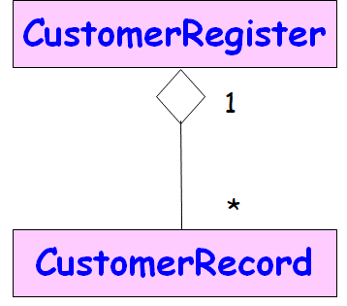
Creator: An Analysis
Creator ensures that coupling due to object instantiation occurs between closely related classes only:
  An aggregate class is already coupled with component class
  Assigning the creation responsibility to the container or aggregate does not increase coupling in the design.

Slide 13
Controller Pattern
Problem: Which class should be responsible for handling actor requests?
Solution: Have a separate controller object for each use case.

Slide 14
Controller
Assign the responsibility for receiving and handling a system message to a:
  Controller object
Do not assign these responsibilities to View classes or model classes:
  A user interface object should never be a Controller.
  Neither is a controller an entity class.

Slide 15
Example 2:Tic-Tac Toe Domain Model
Board
Initial domain model
PlayMoveBoundary
PlayMoveController
Board
Refined domain model

Slide 16
Example 2: Sequence Diagram
:playMove
Boundary
:playMove
Controller
:board
acceptMove
checkMoveValidity
move
[invalidMove]
[invalidMove]
announceInvalidMove
announceInvalidMove
checkWinner
[game over]
[game over]
announceResult
announceResult
playMove
checkWinner
[game over]
[game over]
announceResult
announceResult
displayBoardPositions
getBoardPositions
[game not over]
promptNextMove

Slide 17
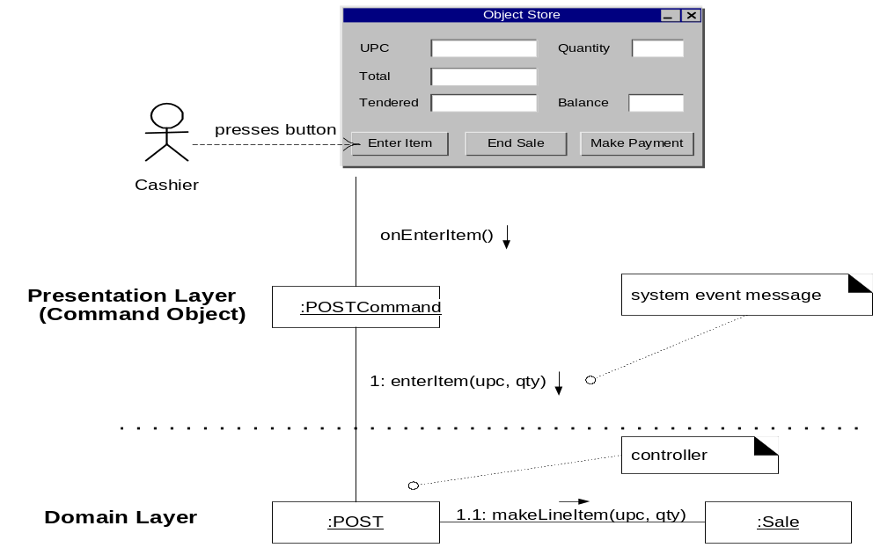
Good design
- presentation layer decoupled from problem domain
Notes:
Assigning the responsibility for system operations to objects
in the domain layer rather than presentation layer supports
increased reuse potential.
• It also makes it easier to unplug the interface layer and use
a different interface technology, or to run the system in an
off-line “batch” mode.

Slide 18
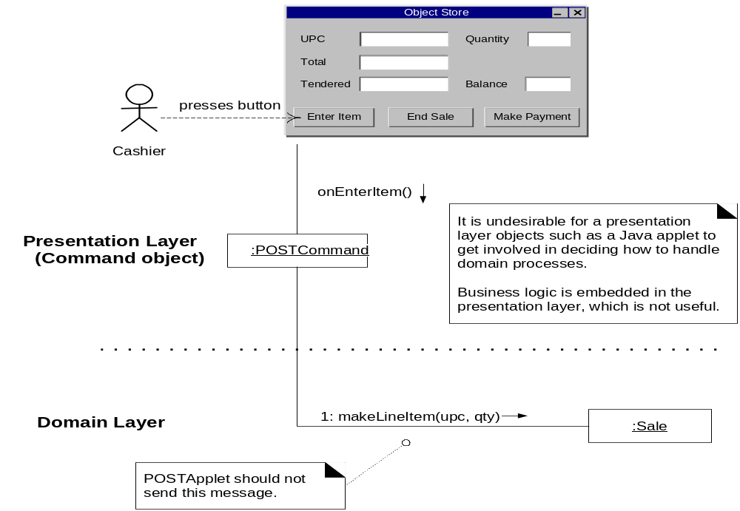
Bad design – presentation layer coupled to problem domain

Slide 19
Bloated Controllers
Signs of a bloated controller:
  A single controller receives many system events
  Controller itself performs tasks instead of delegating them
  Controller has many attributes, maintains a lot of info about the system or domain
    Better to distribute these to other objects
Cure: Refactor
  Add more controllers
  Delegate responsibility

Slide 20
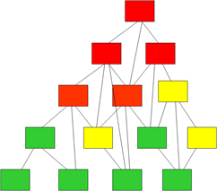
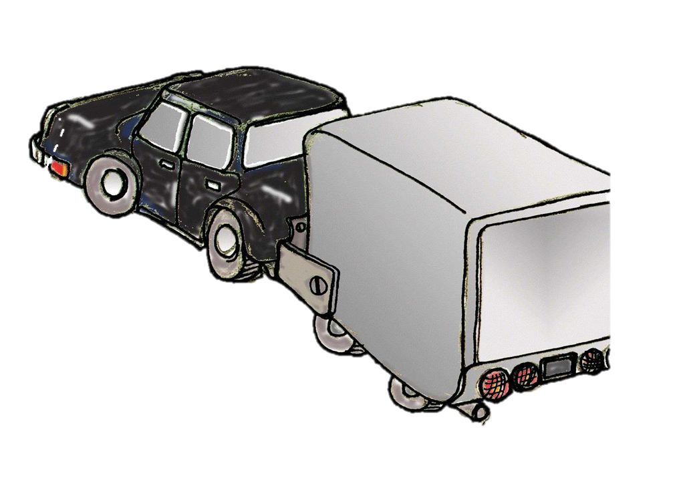
Low Coupling Pattern
Problem: How to reduce coupling in a design?
Why is classes having high coupling bad?
  Developer is forced to change all classes frequently because of changes to related classes…
  Hard to understand in isolation, debug, test…
  Hard to re-use
    Because it requires presence of classes that it depends on
Solution: Assign responsibilities so that coupling remains low.
  Use this principle to evaluate alternatives

Slide 21
Two alternative responses to “Who creates Payment?”
makePayment()
:Controller
1: create()
p:Payment
2: addPayment(p)
:Sale
makePayment()
:Controller
1: makePayment()
:Sale
The second alternative leads to less coupling
  Avoids an association between Controller and Payment
  Sale and Payment already related
1.1: create()
:Payment

Slide 22
High Cohesion
Problem: How to increase cohesion in a design?
What problems arise when a class has low cohesion?
  Hard to comprehend
  Hard to reuse
  Hard to maintain
  Frequent changes required

Slide 23
Example: Controller has Diverse Responsibilities
:Controller
:Sale
makePayment()
create()
p:Payment
addPayment(p)

Slide 24
Better design: Controller delegates, has higher cohesion
:Controller
:Sale
makePayment()
makePayment()
create()
:Payment

Slide 25
Pure Fabrication Background
High Cohesion
  Problem: To keep complexity manageable, Classes should implement cohesive set of tasks.
  Solution: Assign focused and related responsibilities to classes.
Low Coupling
  Problem: To support low dependency and increased reuse.
  Solution: Assign responsibilities so that coupling remains low.
???
???

Slide 26
Pure Fabrication – Background
Suppose a class has responsibilities unrelated to its main task.
  It is a bad design --- low cohesion and high coupling.
  But, how to improve the design?

Slide 27
Pure Fabrication
Problem:
  How to improve a design when a class has very high coupling and low cohesion?
Solution:
  Assign a highly cohesive set of responsibilities to an artificially created class
  May not represent anything in the problem domain...
  Created only to support high cohesion, low coupling, and reuse...

Slide 28
Pure Fabrication: Explanation
Pure Fabrication
Class having High Cohesion
Class having Poor Cohesion
Invented Class
Takes care of a
similar set of functions
Fabrication step: Assign a highly cohesive set of responsibilities to an artificial class.

Slide 29
Pure Fabrication Example
Suppose we need to save instances of SaleTrans in a relational database.
To which class would you assign this responsibility?
SaleTrans has all the information, so SaleTrans is suggested by Expert pattern.
  To manage data transfer to and from a relational database will require a large number of operations … insert, delete, update, select, rollback, commit, buffer management, …
  Cohesion of SaleTrans class reduces…
SaleTrans

Slide 30
Pure Fabrication
Create a new class for the database access related responsibilities:
SalesStorage
SalesStorage class is made up from imagination; it is not present in the Domain Model
insert()
delete()
update()
...
SaleTrans is now well-designed - high cohesion, low coupling
SalesStorage class is cohesive: Its sole purpose is to store/retrieve objects to/from a relational database

Slide 31
Pure Fabrication: Java Snippet
class SaleTrans {
// Process and record the sale for each line item
// Use SaleStorage class for persistent storage
}
class SalesLineItem {
//Process items of similar type and return subtotal
// Use SaleStorage class for persistent storage
}
class SaleStorage{
// Form JDBCDatabase objects to store data to the database
}

Slide 32
Pure Fabrication: An Analysis
Many GoF object-oriented patterns are examples of Pure Fabrication.:
  Examples: Facade, Adapter, Mediator, command, strategy,…
Pure Fabrication may contraindicate the Expert pattern.
  A more informed decision is needed.
Increases Cohesion and reusability

Slide 33
Pure Fabrication: A Reflection
Objects can be divided into two groups:
Representational:
  Representation of entities and their components, such as Sale, Vehicle, Document, …
  These are generally identifiable in the problem description.
Behavioural:
  Often concocted, may also represent an algorithm.
  Examples includes controller classes for use cases, Command class, Strategy class, etc
  These are generally not in the problem domain model, and are mostly pure fabrication.

Slide 34
Delegate Unrelated Responsibility
Delegator
Delegatee
Uses
1
1
Provider
User

Slide 35
Indirection Pattern
Problem:
How to avoid direct coupling between classes?
How to decouple objects so that low coupling is achieved and changes become easy?
Solution:
Depend on an interface class,
  So that objects are not directly coupled.

Slide 36
Indirection: Example
Modem
dial()
receiver()
send()
✗
authorize(payment)
CreditAuthorizationService
1:dial(phoneNum)
Modem
Notes:
Assume that :
A point-of-sale terminal application needs to manipulate a modem in order to transmit credit payment request
The operating system provides a low-level function call API for doing so.
A class called CreditAuthorizationService is responsible for talking to the modem
If CreditAuthorizationService invokes the low –level API function calls directly, it is highly coupled to the API of the particular operating system. If the class needs to be ported to another operating system, then it will requiure modification.
Add an intermediate Modem class between the CreditAuthorizationService and the modem API. It is responsible for translating abstract modem requests to the API and creating an Indirection between the CreditAuthorizationService and the modem.

Slide 37
1
1
<<interface>>
+indirectionIF
Client
Uses
What is the name of this OO principle?
+service1
+service2
Hint:
Program to an interface…

Slide 38
Indirection : Example
Modem Interface
dial()
receiver()
send()
authorize(payment)
CreditAuthorizationService
1:dial(phoneNum)
Modem
<<Interface>>
Modem1
Modem2
Notes:
Assume that :
A point-of-sale terminal application needs to manipulate a modem in order to transmit credit payment request
The operating system provides a low-level function call API for doing so.
A class called CreditAuthorizationService is responsible for talking to the modem
If CreditAuthorizationService invokes the low –level API function calls directly, it is highly coupled to the API of the particular operating system. If the class needs to be ported to another operating system, then it will requiure modification.
Add an intermediate Modem class between the CreditAuthorizationService and the modem API. It is responsible for translating abstract modem requests to the API and creating an Indirection between the CreditAuthorizationService and the modem.

Slide 39
Indirection Advantages
Low coupling
Promotes reusability

Slide 40
Law of Demeter
1
Problem:
How to avoid a class from interacting with indirectly associated classes?
Solution:
If two classes are not directly aware of each other:
  Then these two classes should not directly interact.
*
Item
ItemSpec
Bill
computeTotal
getItemSpec
findPrice

Slide 41
Collaborators

Slide 42
Law of Demeter
In a method, messages should only be sent to the following objects:
  This object (or self)
  An object parameter of the method
  An object attribute of self
  An object of a collection which is an attribute of self
  An object created within the method

Slide 43
LD Violation: Hypothetical example
class A {
private B b = new B();
public void m() {
this.b.c.foo(); // High coupling: bad
}
}
class B {
C c;
}
class C {
public void foo() {
}
}

Slide 44
Law of Demeter: Example
Bill
1
*
Item
ItemSpec
computeTotal
getItemSpec
findPrice
1
*
Bill
Item
ItemSpec
computeTotal
computeSubtotal
findPrice
Violation: item.getItemspec().findprice()

Slide 45
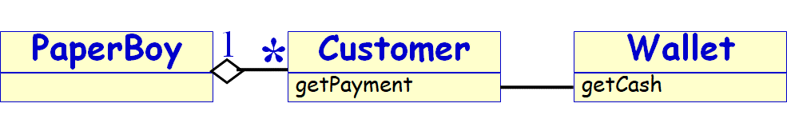
LoD Programming Style
In a class PaperBoy,
  do not use customer.getWallet().getCash(due);
  rather use customer.getPayment(due); and in customer.getPayment (due), use wallet.getCash(due)
Benefit:
  Easier analysis
Tradeoff:
  More statements, but smaller/easier stmts
Experiments show significantly improved maintainability.

Slide 46
Law of Demeter: “Do not talk to strangers”
Don’t send messages to object refs returned from other method calls
public void movePlayer(int roll) {
...
if (currentPlayer.square().isLastSquare()) {
winner = currentPlayer;
}
}
public void movePlayer(int roll) {
...
if (currentPlayer.wins()) {
winner = currentPlayer;
}
}
Better
Notes:
Karl J. Lieberherr, et al. Object-Oriented Programming: An Objective Sense of Style. In Proceedings OOPSLA '88.
The Law of Demeter states that you should only send messages to: an argument passed to you; an object you create; self, super; or your class.
By obeying this law, you avoid unnecessarily coupling your classes. Instead of retrieving data from other objects, you should delegate tasks to them.
Alec Sharp in Smalltalk by Example, McGraw-Hill, 1997, explains this as “Tell, don’t ask”

Slide 47
Law of Demeter: Post Analysis
Reduces coupling between classes
Adds a small amount of overhead in the form of indirect method calls

Slide 48
Law of Demeter: Post Analysis
“The basic effect of applying this Law is the creation of loosely coupled classes, whose implementation secrets are encapsulated. Such classes are fairly unencumbered, meaning that to understand the working of one class, you need not understand the details of many other classes.” Grady Booch

Slide 49
Polymorphism
Problem:
  How to handle alternative operations based on subtypes?
Solution:
  When alternate behaviours are selected based on the type of an object,
  Use polymorphic method call to select the behaviour,
  Rather than using if statement to test the type.
Notes:
polymorphism
has definition A property of object oriented software by which an abstract operation may be performed in different ways in different classes
exists when several classes which each implement the operation either have a common superclass in which the operation exists, or else implement an interface that contains the operation
gets power from dynamic binding
is one of the fundamental features of the object oriented paradigm
dynamic binding
has definition The process of binding a call to a particular method. This is performed dynamically at run-time due to the presence of polymorphism
gives power to polymorphism
is needed when the compiler determines that there more than one possible method that could be executed by a particular call
is a kind of process
prevents programmers from having to write conditional statements to explicitly choose which code to run

Slide 50
AbstractSuperclass
commonOp1
commonOp2
…
variantOp1
variantOp1
…
variantOp1
variantOp1
…
variantOp1
variantOp1
…

Slide 51
Polymorphism : Example
Payment
amount
CashPayment
CreditPayment
CheckPayment
authorize()
authorize()
authorize()
By Polymorphism, each
payment should
authorize itself
Notes:
In the point -of -sale application, who should be responsible
for authorising different kinds of payments?
– Note: Payments may be in
• cash (authorising involves determining if it is
counterfeit)
• credit (authorising involves communication with bank)
• check (authorising involves driver license record)

Slide 52
Polymorphism Pattern: Advantage
Reduced dependency
Easily extendible as compared to using explicit selection logic…
Notes:
Lessons from Polymorphism
• Future extensions required for unanticipated new
variations are easy to add.
• Avoid “case /switch” statements or “if” conditionals on
type.
• The objects work on themselves
– Example: payments authorise themselves
• Also known as: “Do it myself”, “Choosing Message” and
“don’t ask ‘what kind?’”

Slide 53
GoF Patterns

Slide 54
What problems do GoF DPs solve?
Good designs need to cope with change. Why?
  Underlying technologies change
  Business goals change
  User expectations change
How to cope with change?
  Encapsulation
  Inheritance
  Polymorphism

Slide 55

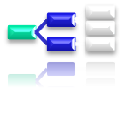

GoF Pattern Classification
Creational | Structural | Behavioral
Abstract Factory | Adapter Proxy | Visitor Command
Factory method | Bridge | Iterator
Builder | Composite | Mediator
Object pool | Decorator | Memento
Prototype | Façade | Observer
Singleton | Flyweight | State
Multiton |  | Template

Slide 56



Classification of Other Patterns
Concurrency | J2EE | Architectural
Active Object | Business Delegate | Layers
Balking | Composite Entity | Presentation-abstraction-control
Double checked locking | Composite View | Three-tier
Guarded suspension | Data Access Object | Pipeline
Monitor object | Fast Lane Reader | Implicit invocation
Reactor | Front Controller | Blackboard system
Read/write lock | Intercepting Filter | Peer-to-peer
Scheduler | Model-View-Controller
Event-Based Asynchronous | Service Locator | Service-oriented architecture
Thread pool | Session Facade | Naked objects
Thread-specific storage | Transfer Object

Slide 57
GoF Patterns: Taxonomy
Creational patterns:
  When and how objects are instantiated?
Structural patterns:
  How objects are composed into larger groups?
Behavioral patterns:
  How are responsibilities distributed?

Slide 58
GoF Pattern Taxonomy
Structural Patterns
  Adapters, Bridges, Facades, and Proxies are variations of a single theme:
    Reduce the coupling between two or more classes
    Introduce abstract classes to enable future extensions
    Encapsulate complex structures
Behavioral Patterns
  Assignment of responsibilities among objects: Who does what?
  Behaviorial patterns concern cohesion and coupling.
Creational Patterns
  The goal is to provide a simple abstraction for a complex instantiation process.
  Make the system independent of the way its objects are created, composed and represented.

Slide 59
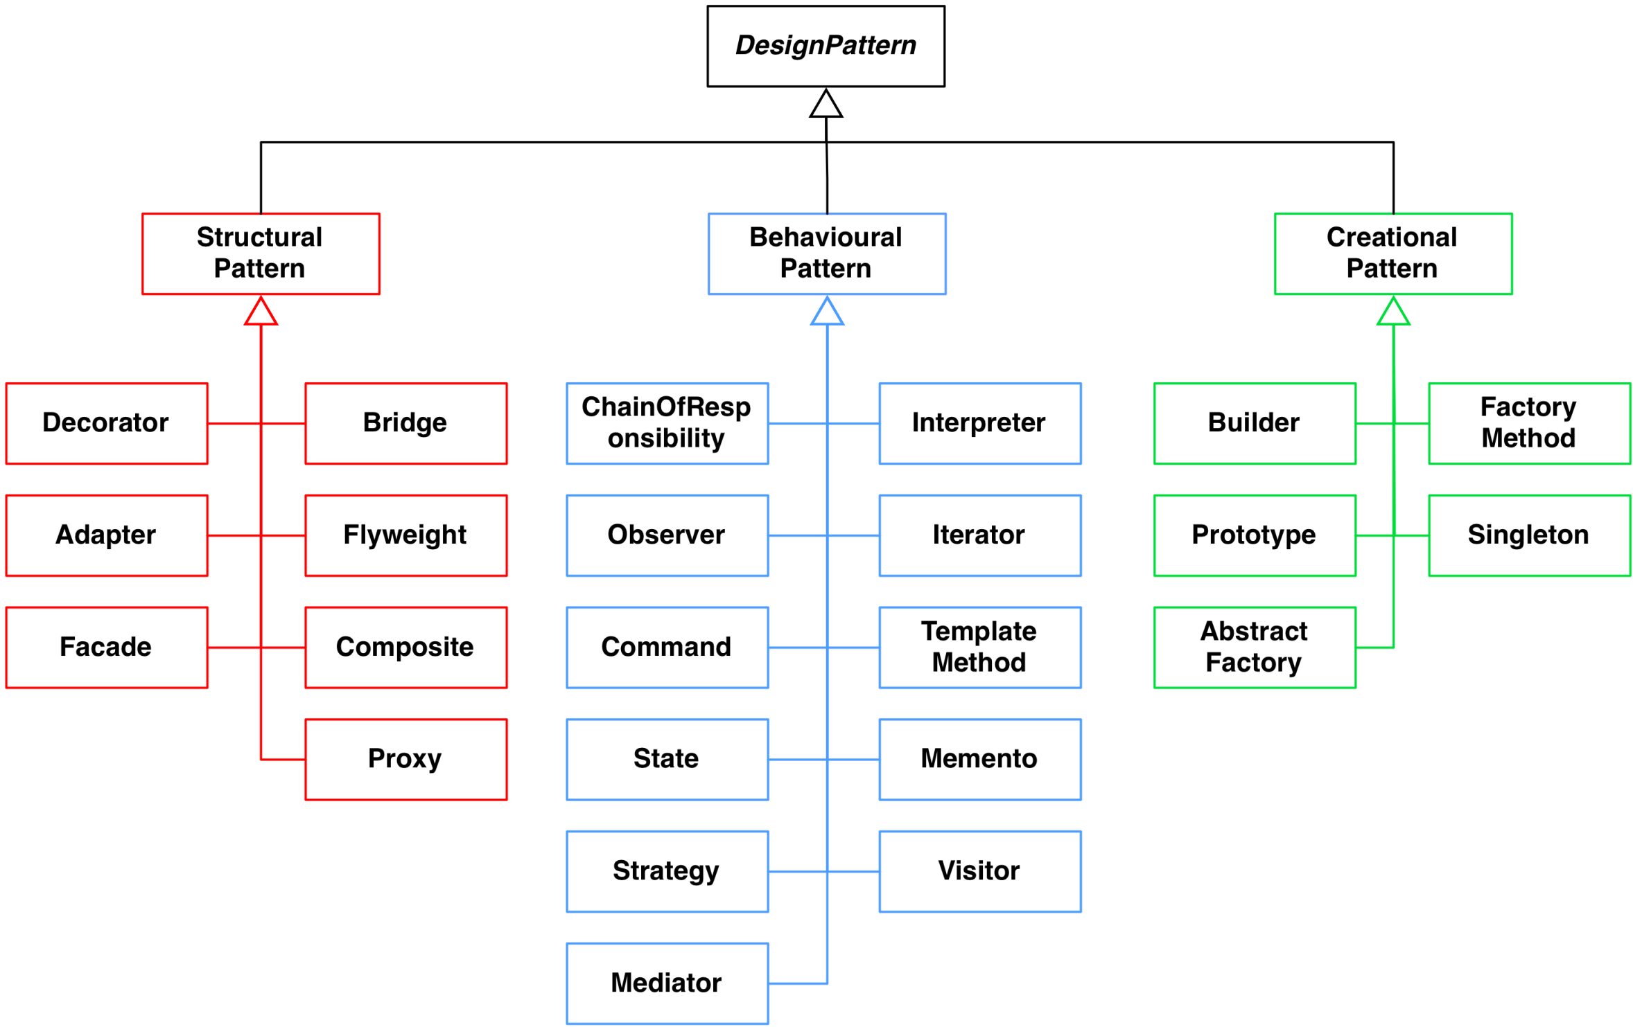
Taxonomy of GoF Patterns (23 Patterns)

Slide 60
Facade Pattern

Slide 61
Facade Pattern
Problem: How to avail services from a large number of classes present in a package?
Context: A package is a cohesive set of classes:
  Example: RDBMS interface package
Solution: A facade class (e.g. DBfacade) is created to provide a common interface to the services offered by the package.
DBA

Slide 62
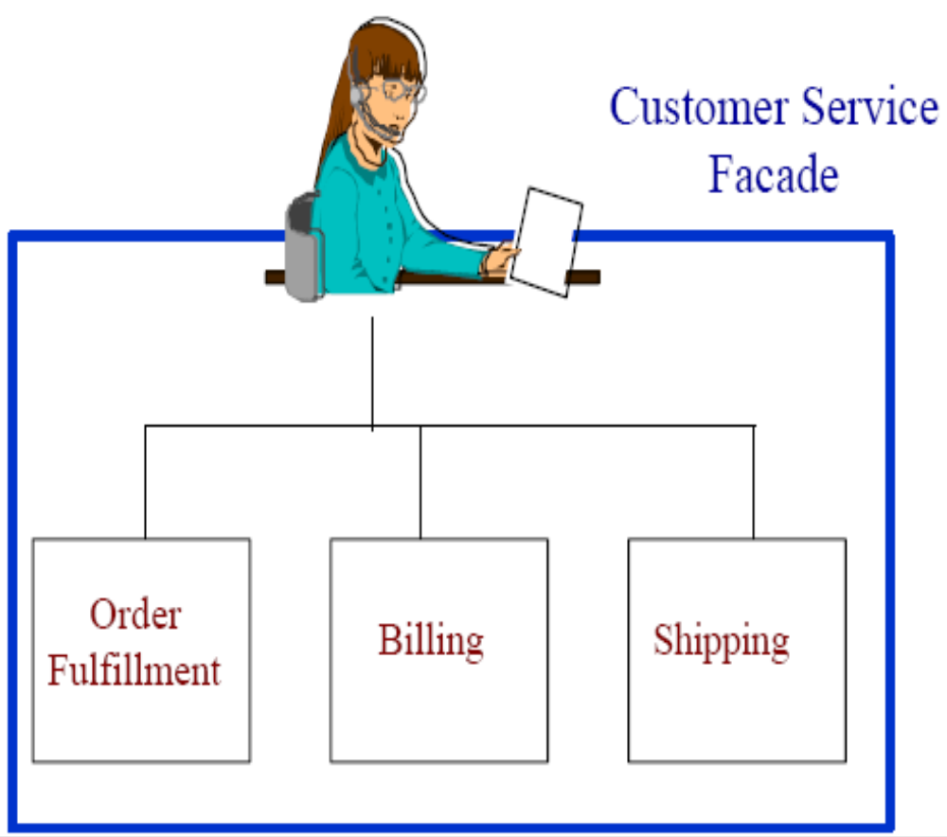
Facade (Non software example)
Provides a unified
interface to a set
of classes in a
system.
  Ordering
Billing
Shipping

Slide 63

Facade
R1
R2
R3
R1
R2
R3
Service Package
Service Package
S1
S2
S1
S2
S3
S4
S3
S4
R4
R5
R4
R5
(a) Service invocation without a façade
(b) Service invocation using a façade class

Slide 64
Before and After Using Facade
Client A
Client B
DBQ
Client A
Database Facade
DBW
Client B
DBR
DBQ
DBW
DBR
Before Facade
After Facade

Slide 65
Facade: Structure
Package
Facade
subsystem classes
A
B
C
E
D
F
G

Slide 66
Facade Pattern Example: Compiler
Compiler
Compile()
Scanner
Token
CodeGenerator
Parser
ProgNodeBuilder
RISCCG
ProgNode
StackMachineCG
Statement Node
Expression Node
Compiler Subsystem Classes
Variable Node

Slide 67
Pattern Name
Security
<<façade>>
SecurityManager
+addAccessRight()
+addActor()
+addActorRole()
+removeActor()
AccessRight
+addAccessRight()
ActorRole
+addActorRole()
ActorManage
+addActor()
+removeActor()
+checkSalary()
Method not in Facade

Slide 68
Façade Example: Bank Package
User
Bank
AccountService
createAccount(…)
deposit(…)
withdraw(…)
Façade
TransactionService
createAccount(…)
deposit(…)
withdraw(…)
addTransaction(…)
applyForLoan(…)
addTransaction(…)
LoanService
applyForLoan(…)
…

Slide 69
Façade: Bank Example
public class BankFaçade {
private AccountService accountService;
private TransactionService transactionService;
private LoanService loanService;
public addAccount(Account account) {
accountService.addAccount(account);
}
public deposit(int accountId, float amount) {
accountService.deposit(accountId, amount);
}
public withdraw(int accountId, float amount) { accountService.withdraw(accountId, amount);
}
public addTransaction(Transaction tx) { transactionService.addTransaction(tx);
}
public applyForLoan(Customer cust, LoanDetails loan) { loanService.apply(cust, loan);
}
}

Slide 70
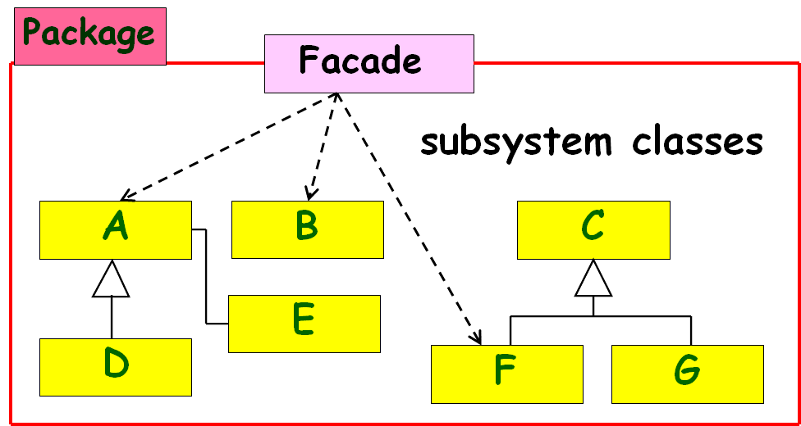
Discussions on Façade Pattern
Clients communicate only with the Façade:
  Façade forwards each request to the appropriate subsystem object(s).
  Promotes low coupling; clients need to know only about the Façade.
A Façade often does little more work than simply delegating requests to other classes inside the package!

Slide 71
Discussions on Façade Pattern
Although subsystem objects perform actual work:
  Façade may have to translate between subsystem interfaces.
Clients are aware of only the Façade:
  Don’t have to directly access any other objects in the package.

